Slide 1
AGILE SCRUM

Slide 2
Agile Scrum is a lightweight framework for software development.
It is based on the principles of iterative development, incremental delivery, and continuous improvement.
Agile Scrum teams work in short sprints, typically two weeks in length.
At the end of each sprint, the team delivers working software to the customer.

Slide 3
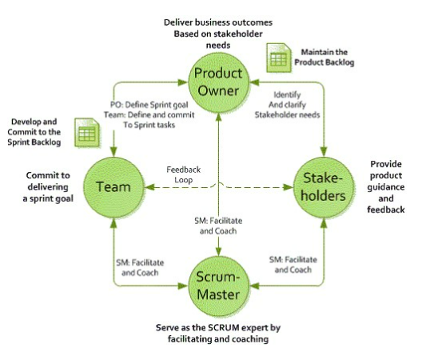
1.SCRUM ROLES

Slide 4
Product Owner: The Product Owner is responsible for the product vision and backlog.
Scrum Master: The Scrum Master is responsible for facilitating the Scrum process and removing impediments to the team's progress.
Development Team: The Development Team is responsible for developing the product.

Slide 5
2.SCRUM ARTIFACTS
Product Backlog: A list of all the features and changes that need to be made to the product.
Sprint Backlog: A list of the work that the team will complete in the upcoming sprint.
Burndown Chart: A chart that shows the team's progress towards completing the sprint backlog.

Slide 6
3.SCRUM EVENTS
Sprint Planning: The team plans the upcoming sprint.
Daily Scrum: The team meets daily to synchronize their work and identify any blockers.
Sprint Review: The team presents the work they completed in the sprint to the stakeholders.
Sprint Retrospective: The team reflects on the previous sprint and identifies ways to improve.

Slide 7
4.SCRUM METRICS
Scrum metrics are specific data points that scrum teams track and use to improve efficiency and effectiveness.
Scrum teams use metrics to inform decision-making and become more efficient in planning and execution, as well as set target goals and improvement plans.

